Slide 1
LARGYMORE PRIMARY SCHOOL
P1 INFORMATION
September 2023

Slide 2
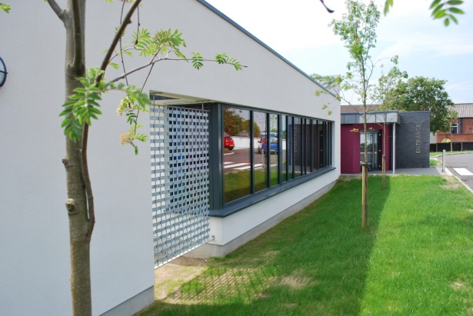
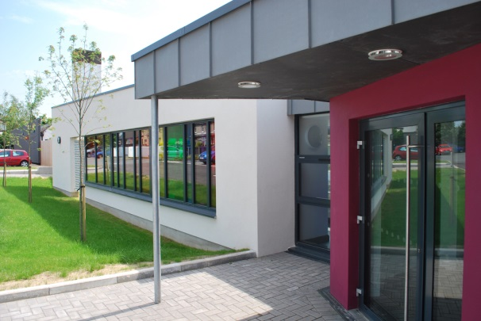
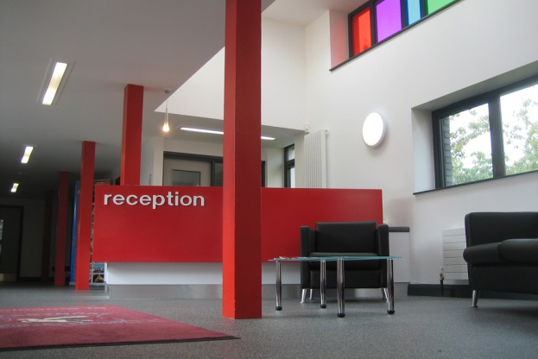
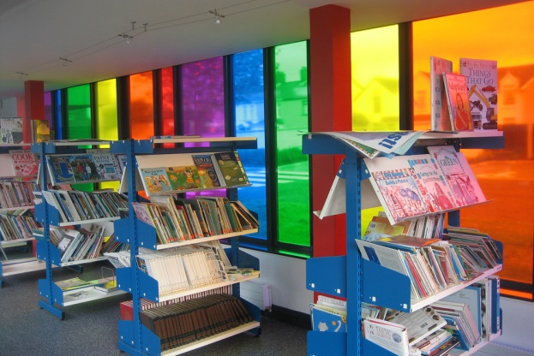
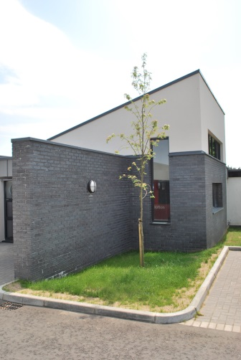
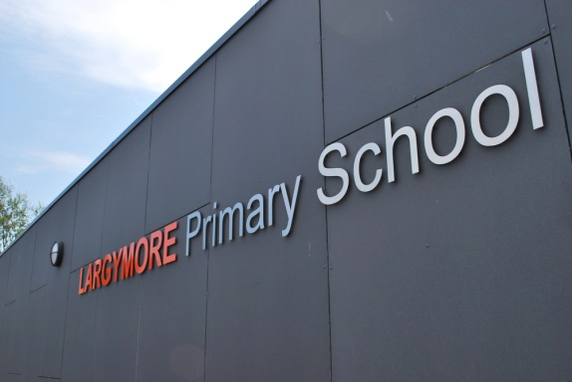
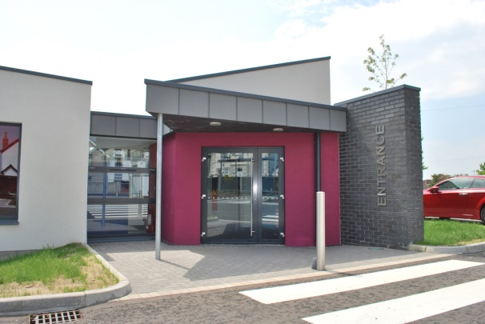
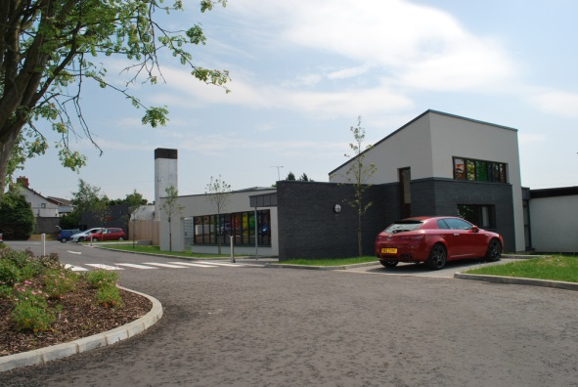
Notes:
It was so lovely to talk to everyone last week. I am delighted to welcome you all to the P1 classroom.

Slide 3
Whose who?
Teacher: Mrs Gamble
Classroom Assistants: Mrs Weldon and Mrs Massey
Acting Principal: Mr Henry
Vice Principal: Mr Noble
Secretary: Mrs Martin

Slide 4
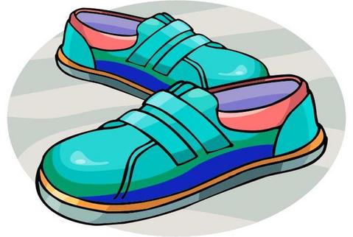
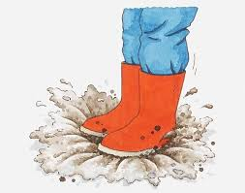
What do P1 need?
Clear book bag/ Homework Folder- Please look after these.
Labelled Coats everyday.
Water bottle (labelled) – kept in tray outside classroom for when they want a drink.
PE- Please wear PE Kit on Wednesdays and Thursdays. Please bring in black plimsoles.
Outdoor Play-
Please send in labelled Wellington Boots as soon as you can. These will remain in school all year.

Slide 5
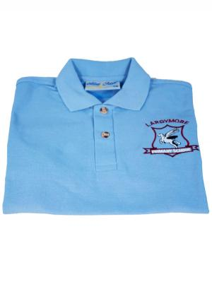
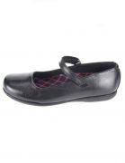
Uniform
Please work on putting on and taking off own jumper and coat independently.

Slide 6
P1 Curriculum
We will be looking at six areas of learning -
1. Language & Literacy
2. Mathematics & Numeracy
3. The World Around Us
4. The Arts
5. Personal Development Mutual Understanding
6. Physical Development & Movement

Slide 7
Our Topics
September – October
Marvellous Me /
(People Who Help Us)
November – December : Once Upon a Time
January – February:
Winter
March – April:
On the Farm
May – June:
Amazing Journeys

Slide 8
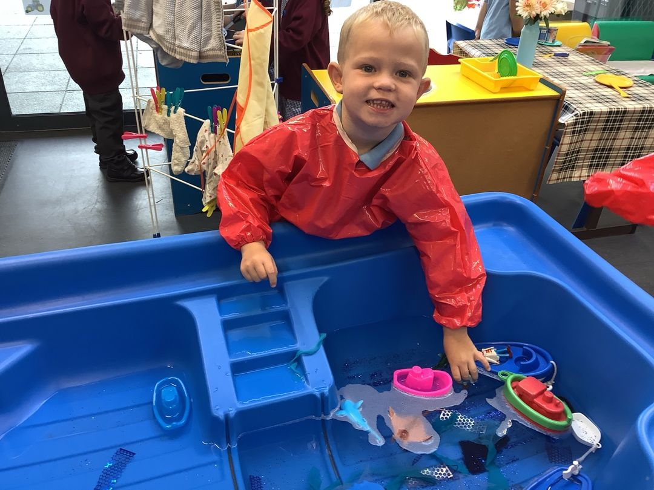
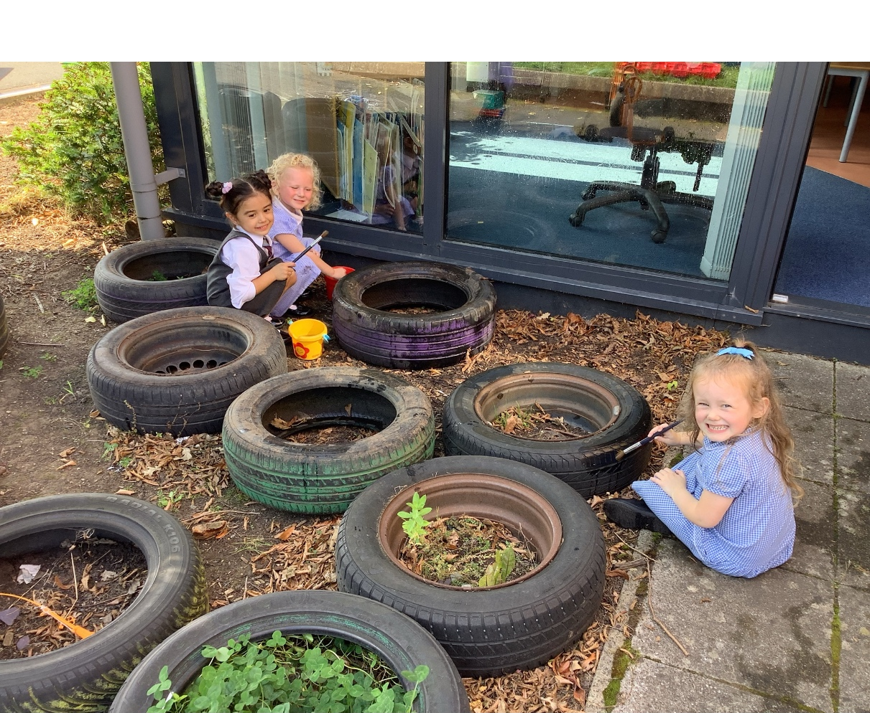
Play Based Learning
• Daily
• Important part of our day
• Opportunities for outdoor and indoor play
“Children need the freedom and time to play. Play is not a luxury. Play is a necessity.”

Slide 9
Reading
We have already begun to do Shared Reading, Nursery Rhymes and book handling skills with the children. We will be using lots of books and stories each day to familiarize them with text, pictures and drawing understanding from what they hear and begin to read themselves.
I will be sending reading books home later in the term.
Please read to your child at home. Make sure to join Lisburn library or use books you have at home to read and have fun.
Bedtime is a perfect time for a good story and it is so important!

Slide 10
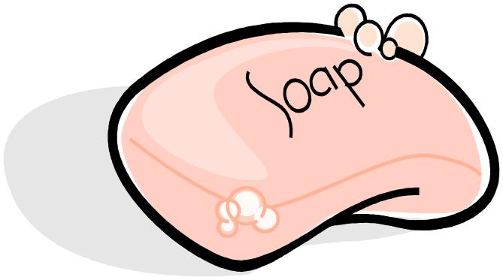
Teaching Phonics…
We use the Jolly Phonics programme to help our children to learn their sounds. They will learn a sound, find words beginning with the sound and learn how to write the sound.
They will quickly learn a song to match and remind them of the sound. It is a fantastic way for them to retain information, having lots of fun as they learn!
Sounds will build into words quickly. ie s-a-t.
Please have a look at the Jolly Learning website for lots more information.

Slide 11
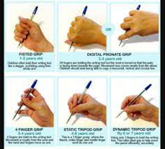
Handwriting
To develop a comfortable pencil grip, we encourage children to …
1. Place the pencil on the table with the lead pointing towards you
2.Nip the pencil near the lead, between thumb and index finger
3. Flip it over so it rests between your finger and thumb
4. Grip it quite firmly.

Slide 12
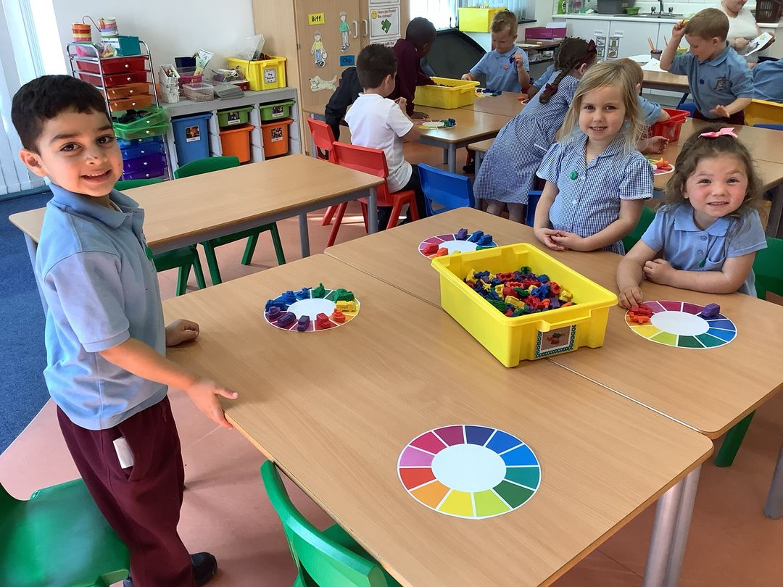
Mathematics and Numeracy
Number rhymes
Working on numbers within 10
Counting well beyond 10
Lots of problem-solving tasks
Addition
Pattern and Shape
Money

Slide 13
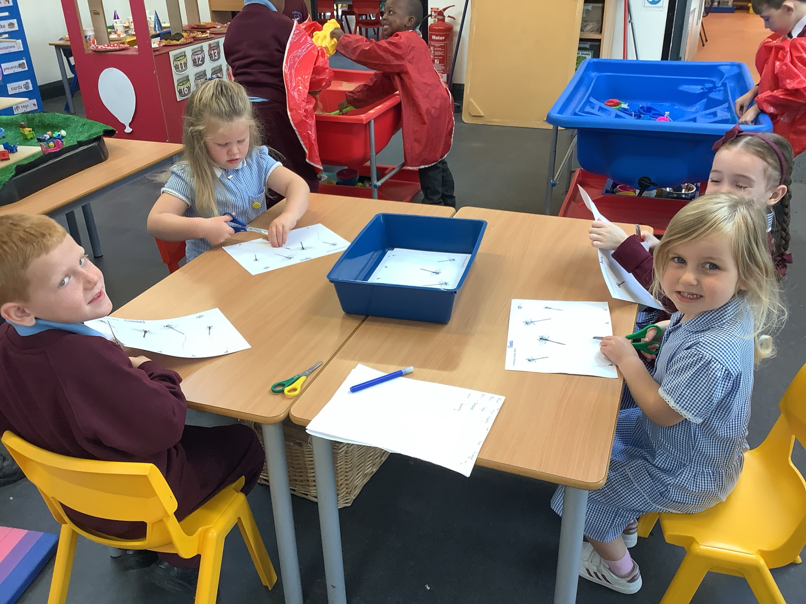
Scissor Skills
Practice lots at home
Remind your child to keep their thumb at the top.
Turn the page, not their hand.

Slide 14
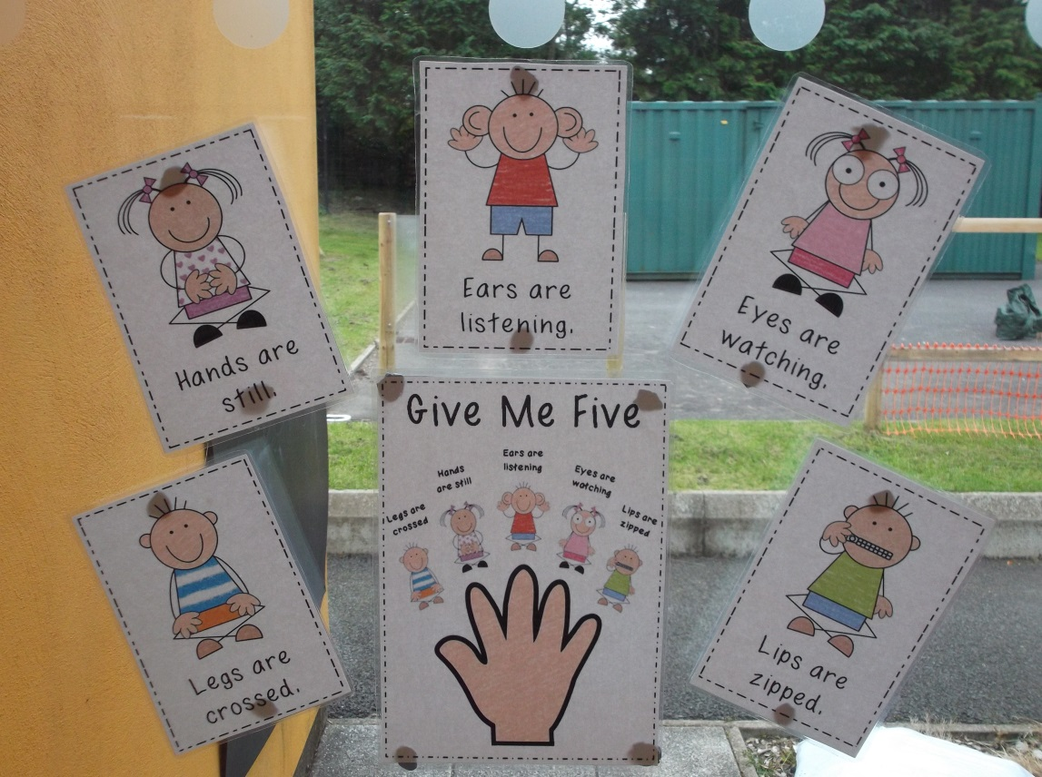
Classroom Management
Listening is the foundation block for learning language. Language is the foundation block of learning in school. Children need help to learn listening skills”
Some activities we use in school include ..
• Wait for word ‘go’
• Echo clapping / Singing
• What comes next?
(Say a rhyme and pause at times to allow children to say the next word)
•‘Give me five’ helps us to be ready to learn.
We use lots of pictures to help the children to understand what they are being asked to do.

Slide 15
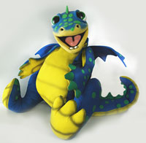
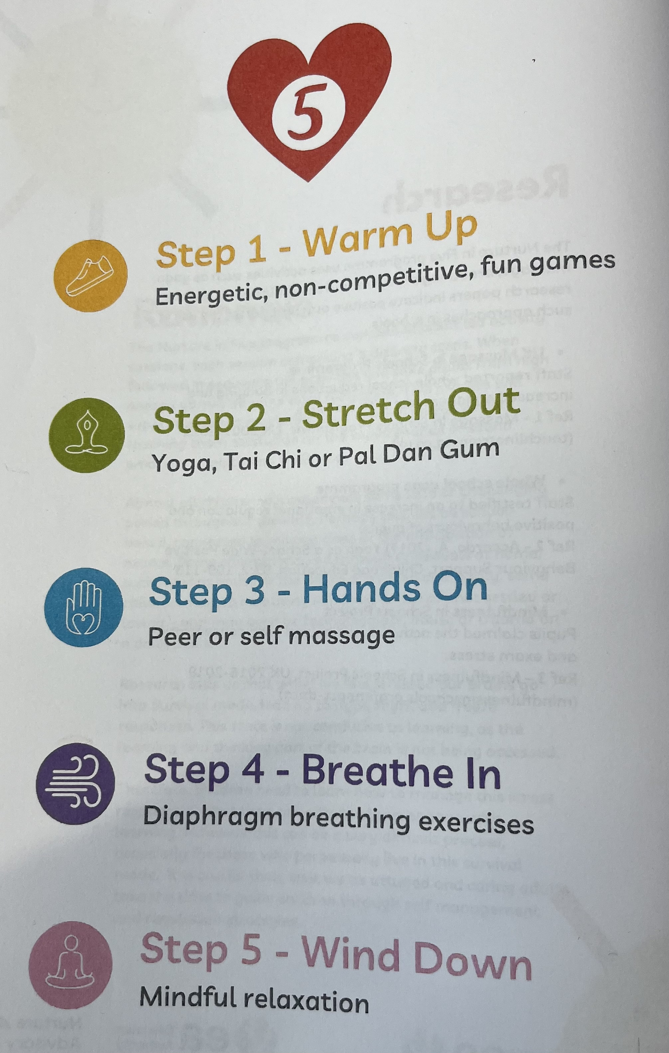

Slide 16
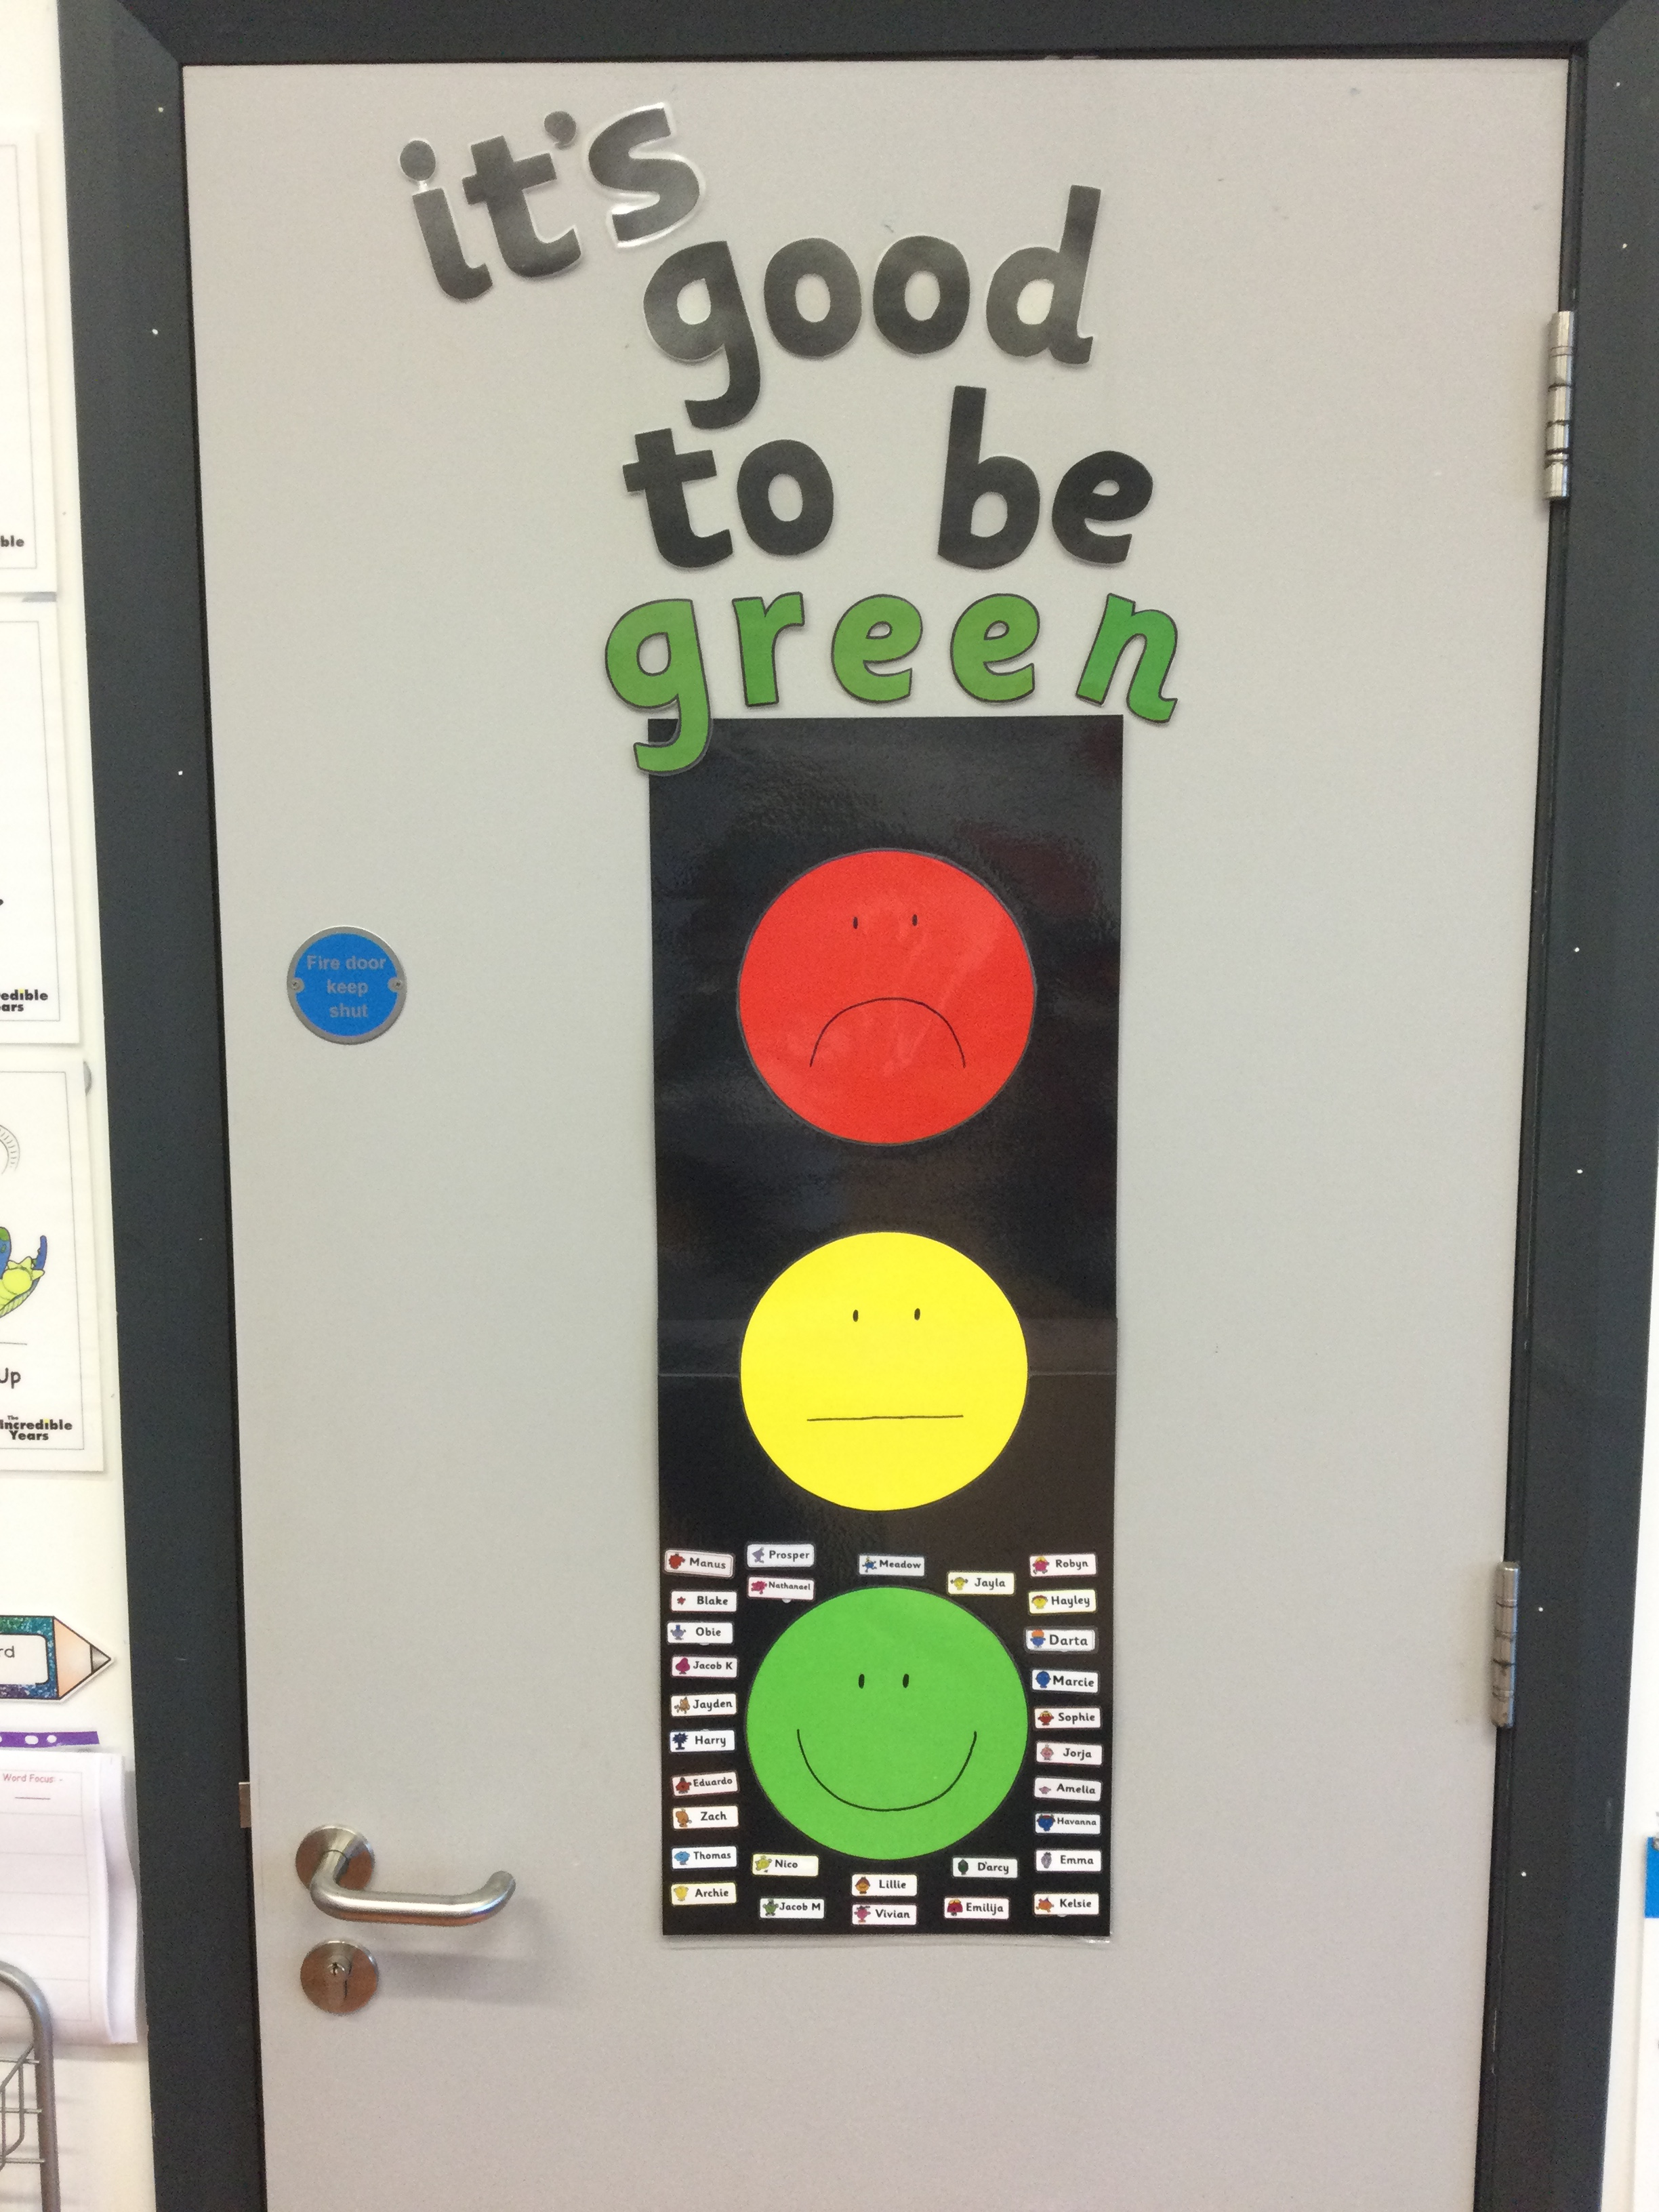
Positive Behaviour
We expect and encourage the children to be the best that they can be. This will allow them to reach their full potential.
Notes:
To help us with this we use a positive behaviour chart. The children’s names will be on the green smiley face. If they break a class rule they will move to the yellow face and if they misbehave again their name will go to the red sad face.
There are some exceptional circumstances where they can move straight to the red sad face. If the child is on the red sad face they will then miss 5 minutes off their outside play time.
Three occurrences on red will mean a visit to see Mr Henry.
We aim to keep everyone’s name on the green smiley face.

Slide 17
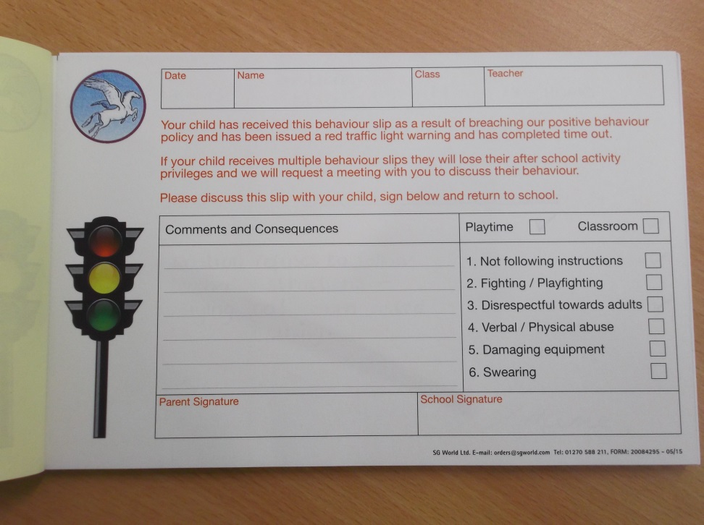
This is our school behaviour book which may be used if a child is continually breaching the positive behaviour policy/ three times on Red.
Hopefully we will have no need for this in P1!

Slide 18
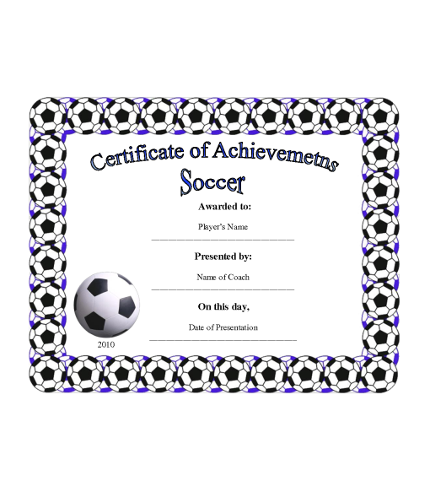
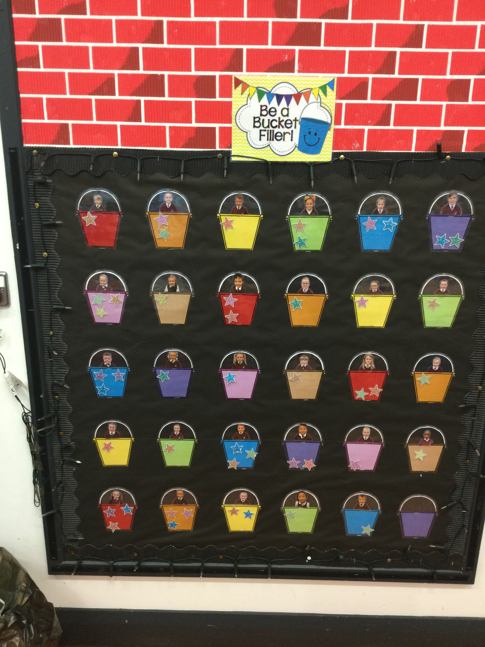
Celebrating Achievements
P1 Stars
Table of the Week
Whole School Star of the Week
Achievements from inside/outside school
Birthdays

Slide 19
Home Learning Activities…
Important to ask your child about their time in school each day…
Complete-
Phonic Sound Book/ Phonic Sound Cards
High Frequency Word Book
1/2 Written/Seesaw Activities
Reading Books – later in the term.
Everywhere Bear
Homework will start next week. All homeworks to be handed in on Thursdays. Clear instructions on what to do will be provided.
Notes:
Working with your child on their homework will allow your child to work at a much faster pace/ succeed through the P1 curriculum.

Slide 20
Home/School Communication…
Seesaw – This will be our main means of communication. However, this is not checked daily so if the matter is urgent please contact the office. You can phone the school office to arrange a phone call with a teacher if you would like to chat to me.
Friday Note
The Largymore Website
Parent interviews- First will be week beginning 13th November.
Absence Notes
PLEASE CHECK BOOK BAGS EVERY DAY & EMPTY THEM

Slide 21
Child Protection in School
School Drop off and Pick up-
From next week we would appreciate if you would leave your child off at the gate and collect at hometime from the gate.
Hometime-
Please talk to your child about waiting in the line until we dismiss them one at a time. This will ensure safety.

Slide 22
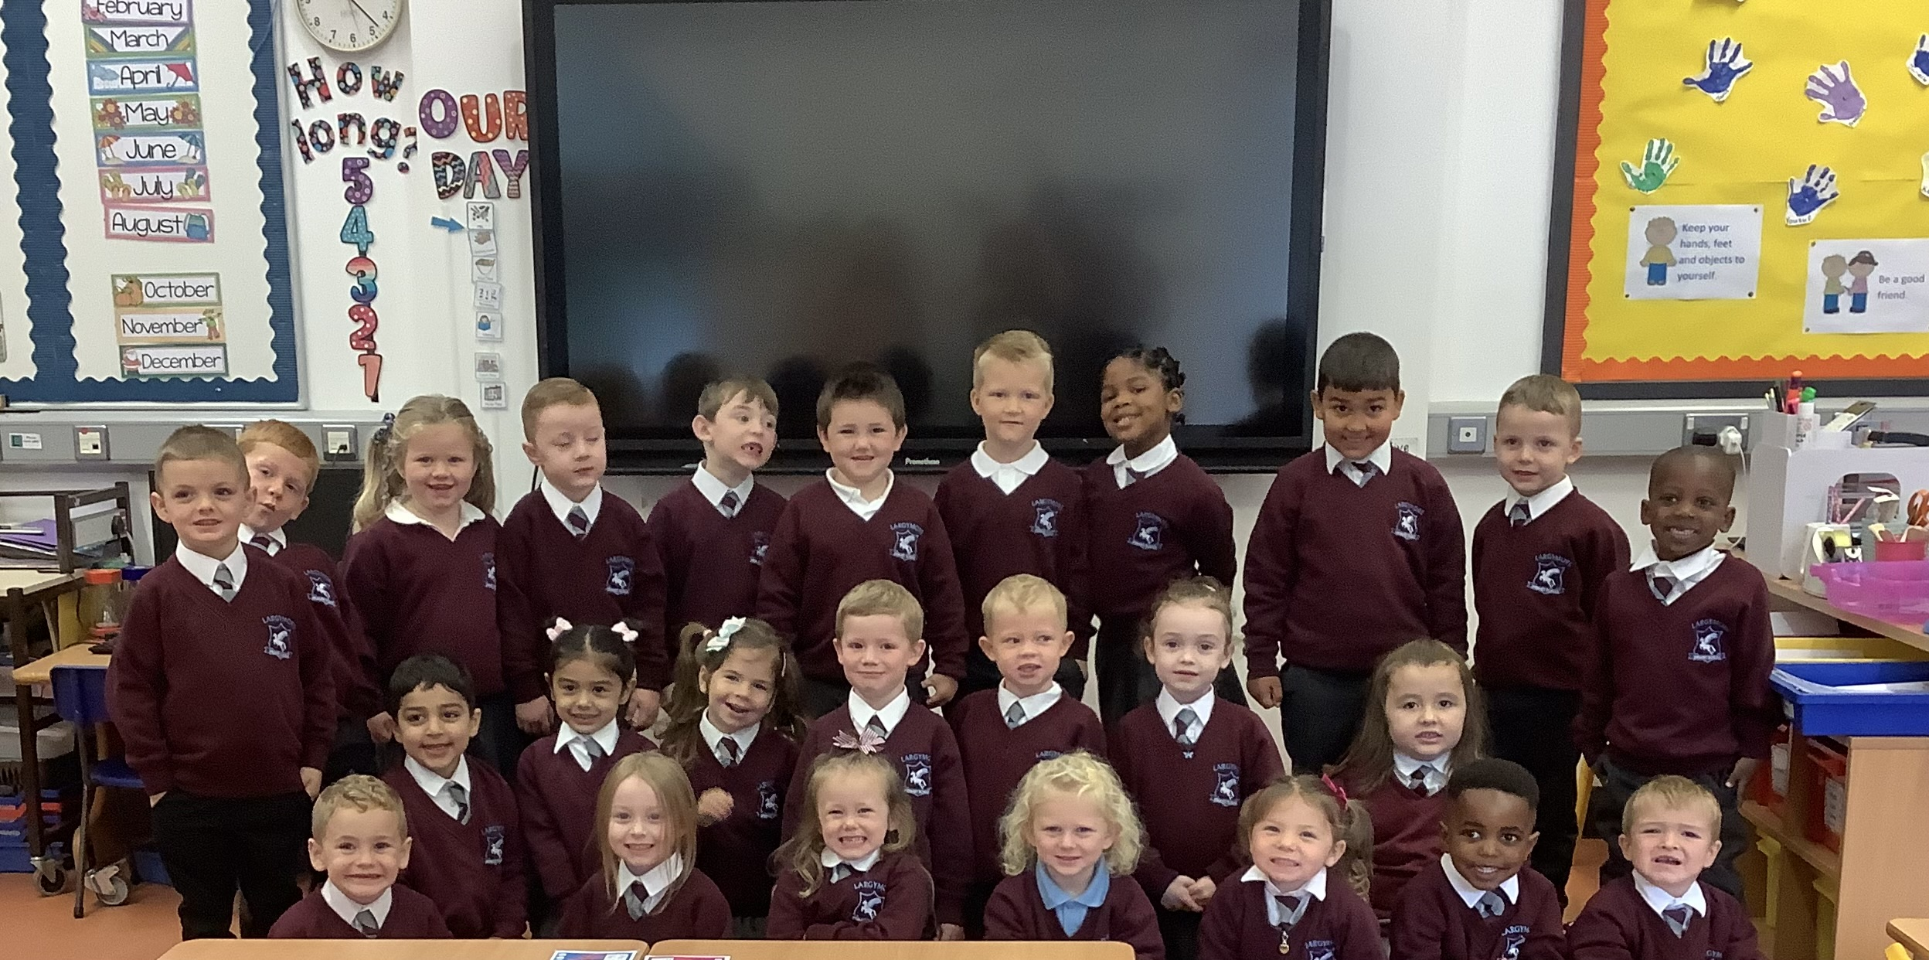
Thank you very much for coming today.
Notes:
I really look forward to working together with you and your child this year.

